Slide 2



Big data with Hadoop
What? Why? How?

Slide 3
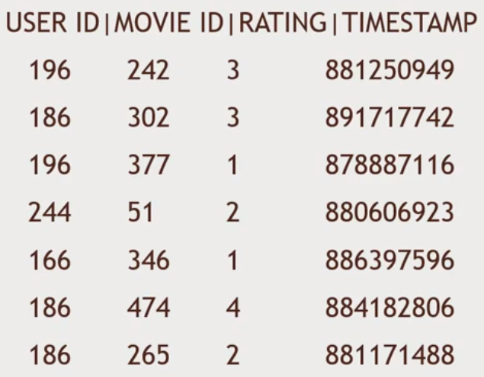

Imagine that you are a data scientist!

Slide 4


What is Hadoop?
Hadoop is an open-source software framework used for distributed storage and distributed processing of very large dataset on computer clusters built from commodity hardware.

Slide 5
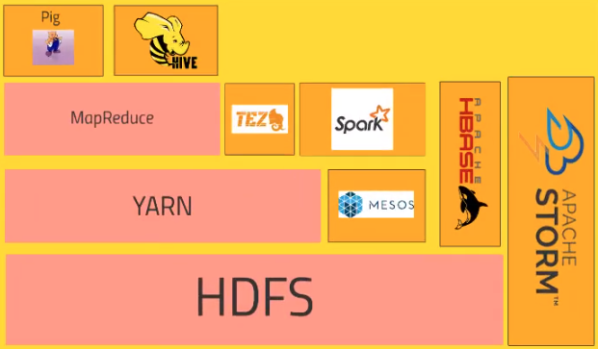
Hadoop ecosystem!

Slide 6

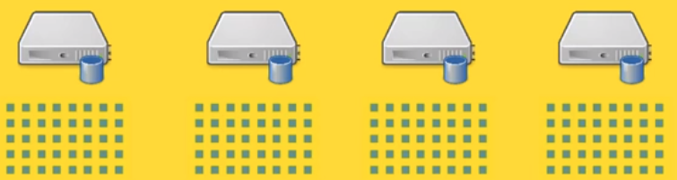
Breaking the big data into blocks!

Slide 7
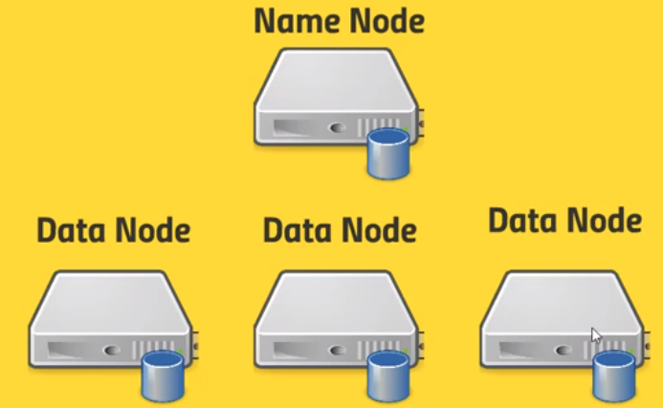
Name node VS data node!

Slide 8

What is mapreduce?

Slide 9
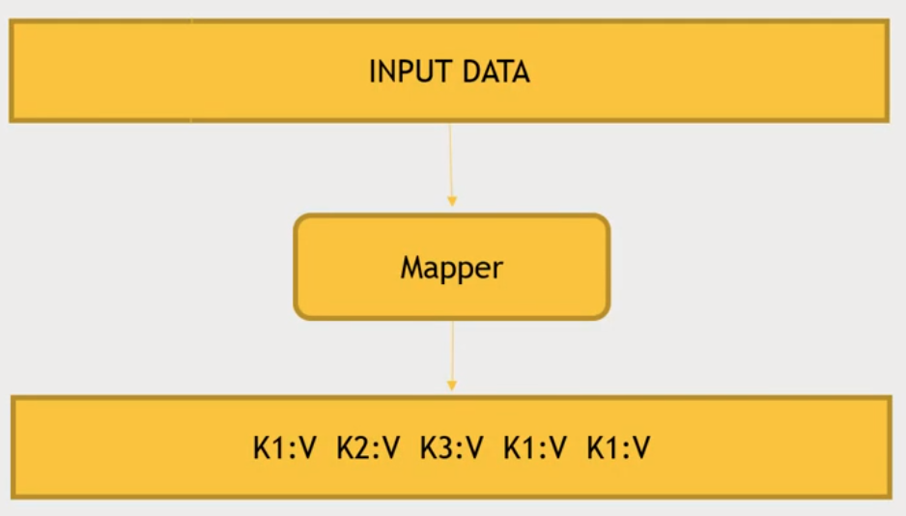
mapreduce! (Cont.)

Slide 10
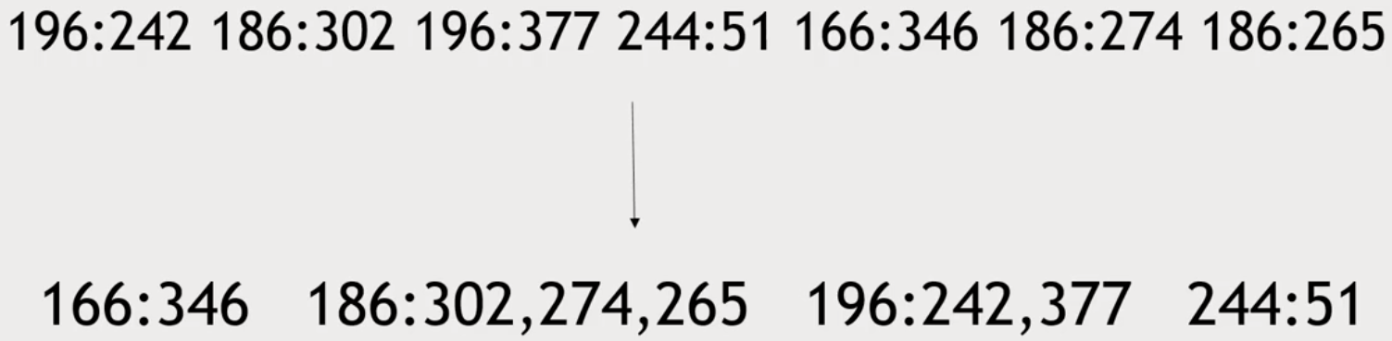
Mapreduce, shuffle and sort! (Cont.)

Slide 11
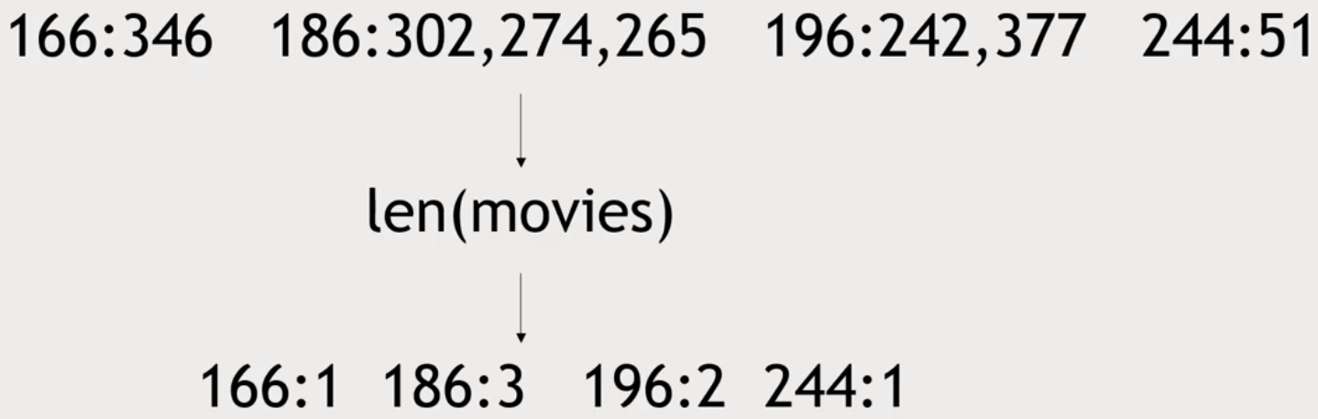
mapreduce! (Cont.)

Slide 12
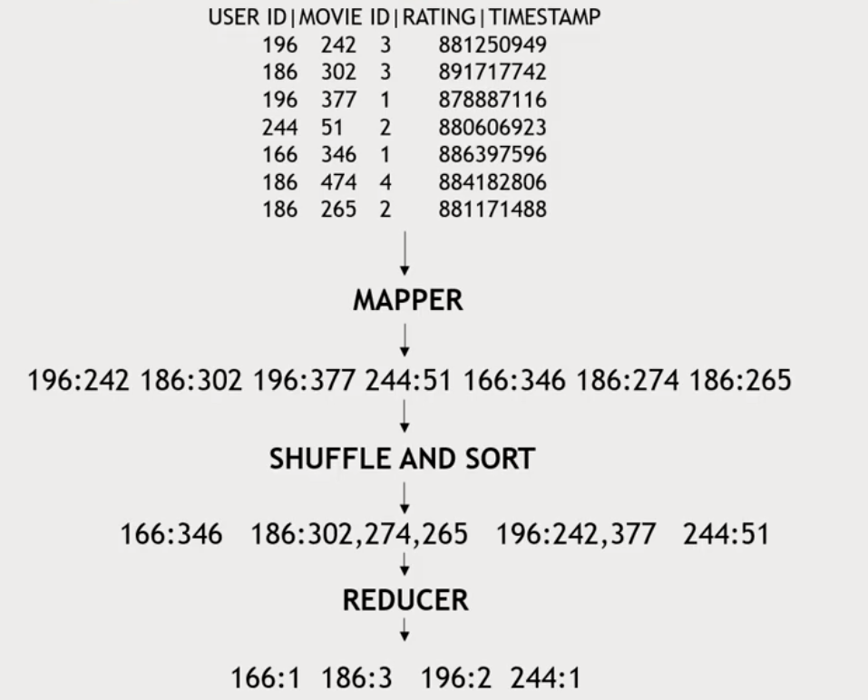
Let’s get all together!

Slide 13
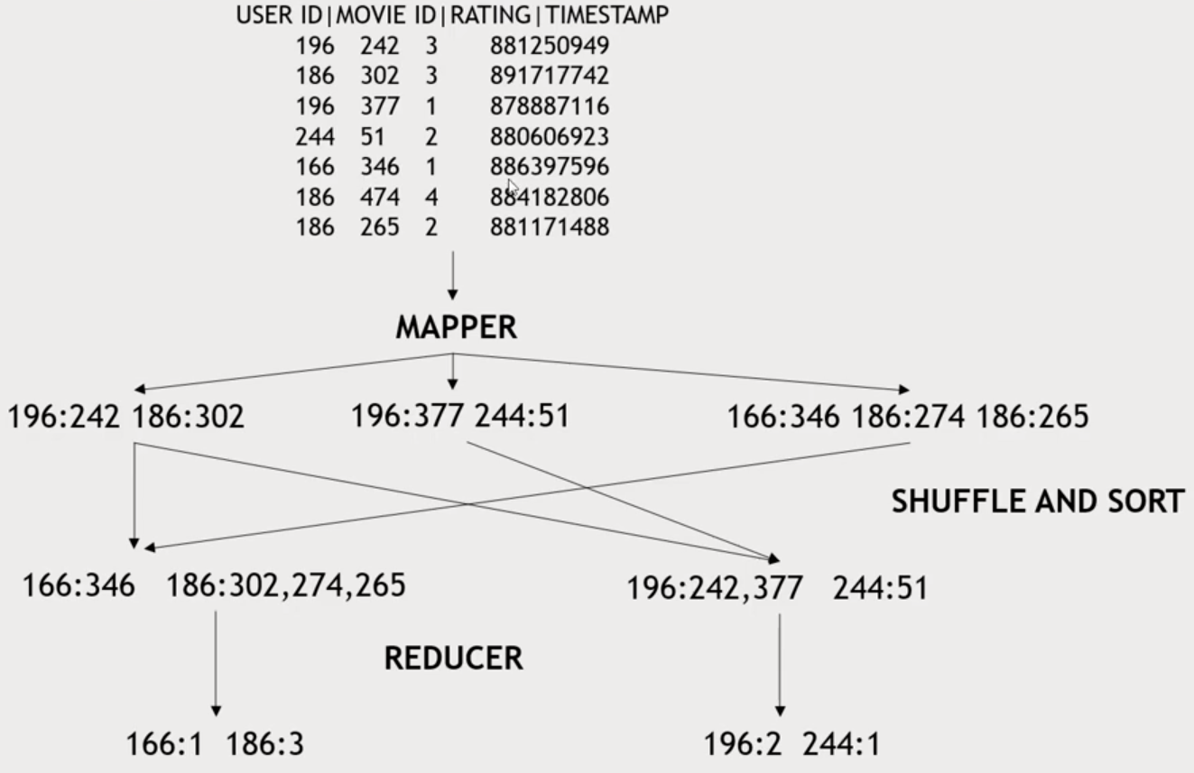

Let’s get all together! (Cont.)

Slide 14

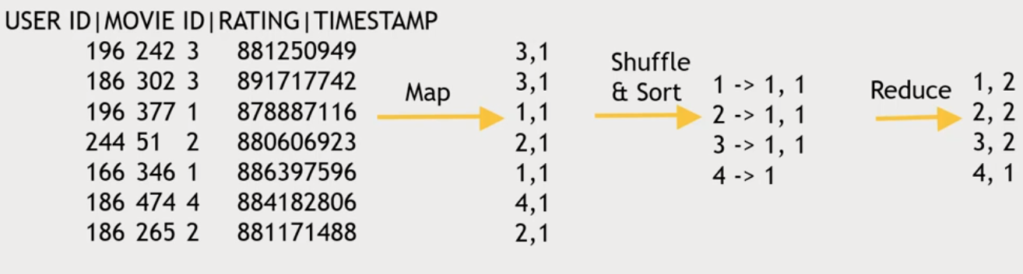
Another example!

Slide 15
Just a recap!
Hadoop: distributed storage and processing, open source, commodity computers
HDFS: hadoop distributed file system for reliable and distributed storage, name node and data node, fail tolerate,
Mapreduce: map(transform) and reduce (aggregate). Alternatives, pig and spark

Slide 16


It’s a long journey!

Slide 17



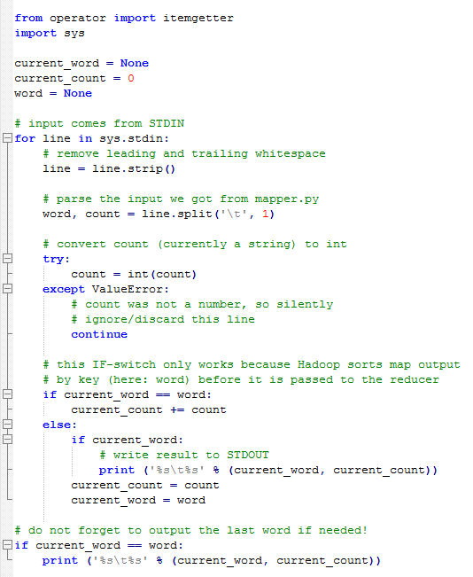
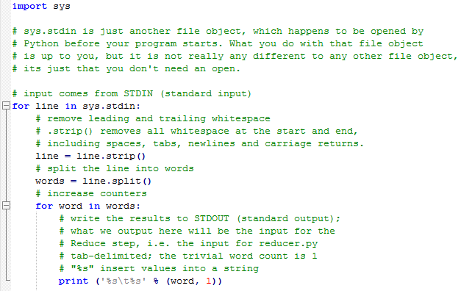
Let’s code! (mapreduce in python)

